Slide 1
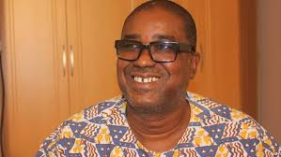
Herman Chinery-Hesse(founder soft tribe limited)
Founded in 1991.
Is the leading software development company in Ghana.
It has experience in the design and implementation of computerised business application systems.
The company has over 300 clients over the years.

Slide 2
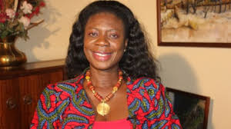
Patricia Poku
Executive Director at Data Protection Commission – Ghana.
Mission is to protect the privacy of the individual and personal data by regulating the processing of personal information.
Their vision is to be recognised by all stakeholders as an independent, efficient and effective data protection regulator in the country and Africa.
Main goal was to make Ghana the leading example for Data Protection in Africa.

Slide 3
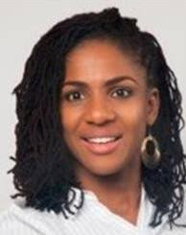
Farida Bedwei(founder logiciel ghana)
Tech company that delivers core banking,mobile banking and cash mobilisation platforms in Africa.
The founder has been a great influence in this IT corporation.
Their client include-phoenix life insurance,bayport financial services.

Slide 4
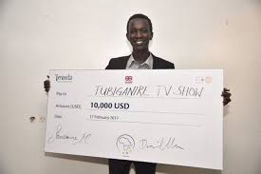
Sylvie Uhirwa(rwanda)
Co-founder of tantine app.
The app is used to solve health issues among the young people in rwanda.
Aim of the app is to use tech to teach and give teenagers reproductive health information.

Slide 5
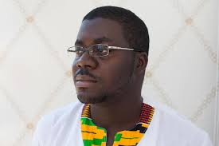
Raindolf Owusu
Founder of oasiswebsoft.
It was founded in july 2011.
It’s aim was to create advanced software solutions for web applications,websites and enterprise solutions.
Innovations include;BISA,which provides valuable health information,tips of managing your health,and support to those who seek information.

Slide 6
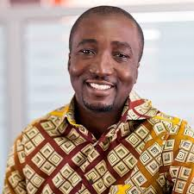
Derrydean Dadzie
CEO of dream Oval.
This company was formed when 5 graduates from Ashesi university.
Came together to persue a dream of creating an IT company calling themselves the Doers.

Slide 7
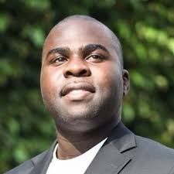
Eyram Tawia
Founder of leti games.
This is a development company based in Ghana and kenya.
Their aim is to create the next african super heroes through comics and games.
Founded in 2009,due to the lack of skilled people and video games development studios.
The company also develops fun and interactive apps for third party clients.

Slide 8

Dr Theresa Oppong Beeko
founder and chief executive officer of Manet Incorporated.
It’s mission is to provide unique,safe,functional and good housing units and environmentally-friendly community.

Slide 9
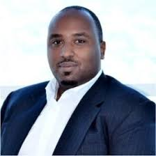
Emile Kinuma(rwanda)
Chief executive officer mobicash.
Mobicash is used for sending money to someone.
Mobicash is free to open.
No need to update your phone or get a new simcard to use this account.

Slide 10
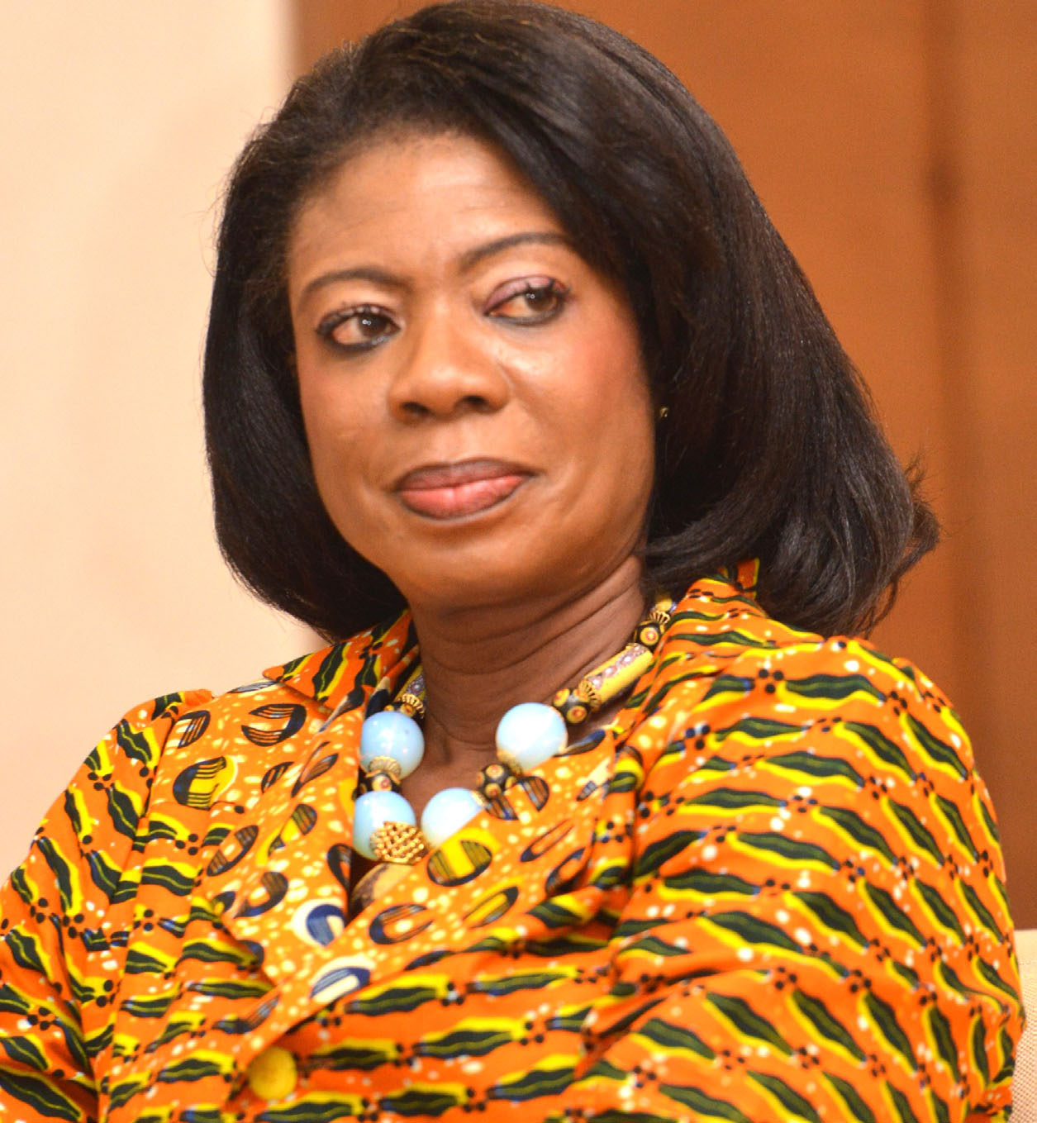
Kate Quartey-Papafio
Ghana entreprenuer (kate)
Founded Reroy cables ltd in 1992 to dristribute high quality electrical cables.

